Slide 1
Comparison of Greek Adjectives
Prof. Vanessa Gorman
University of Nebraska-Lincoln
vgorman1@unl.edu

Slide 2
Adjectives (and adverbs) have degree
Positive = the normal form
Fast, high, hostile, friendly
Comparative = “more” or “-er”
Faster, higher, more hostile, more friendly/friendlier
Superlative = “most” or “-est” or “very”
Fastest, highest, most hostile, most friendly/friendliest, very friendly

Slide 3
Most regular adjectives
Form comparative by adding –τέρος, -τέρα, -τέρον to the stem
φιλώτερος, φιλωτέρα, φιλώτερον (more friendlier, friendlier)
πολεμιώτερος, πολεμιωτέρη, πολεμιώτερον (more hostile)
πρότερος and ὕστερος (earlier and later)
πρότερον and ὕστερον = adverbial accusatives (earlier and later)
Form superlative by adding –τατος, -τάτη, -τατον to the stem
φιλώτατος, φιλωτάτη, φιλώτατον (most friendly/friendliest)
πολεμιώτατος, πολεμιωτάτη, πολεμιώτατον (most hostile)

Slide 4
Most regular adjectives
The neuter singular accusative comparative adjective may be used as the comparative adverb.
πολεμιώτερον can mean more hostilely.
ὕστερος, -η, -ον is a comparative form [no positive]
ὕστερον is often used adverbially
Sometimes they use the form πολεμιωτέρως
The neuter plural superlative adjective may be used as the superlative adverb.
πολεμιώτατα can mean most hostilely.

Slide 5
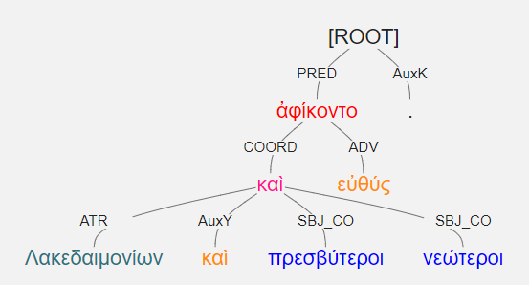
Λακεδαιμονίων καὶ πρεσβύτεροι καὶ νεώτεροι εὐθύς ἀφίκοντο. [3.3.8]
The older men and the younger men of the Lakedaimonians arrived immediately.

Slide 6
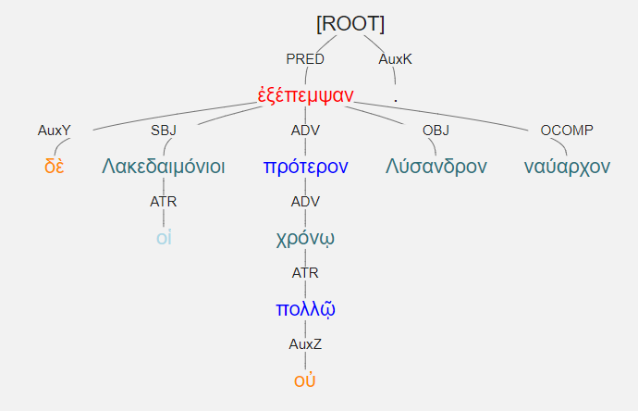
οἱ δὲ Λακεδαιμόνιοι πρότερον οὐ πολλῷ χρόνῳ Λύσανδρον ἐξέπεμψαν ναύαρχον. [1.5.1]
Not long before, the Lakedaimonians sent Lysander as naurarch. [Literally, before by not much time. Dative of degree of difference.]

Slide 7
Irregular comparatives/superlatives
πολύς
πλείων
πλεῖστος, -α, -ον
μέγας
μείζων
μέγιστος, -α, -ον
κακός
κακίων or χείρων or ἥττων
κάκιστος or χείριστος or ἥκιστος
ἀγαθός
ἀμείνων or βελτίων
ἄριστος, -α, -ον or βέλτιστος, -α, -ον
καλός
καλλίων
κάλλιστος, -α, -ον
ἐχθρός
ἐχθίων
ἔχθιστος, -α, -ον

Slide 8
Superlatives are declined like regular three-ending adjectives
κράτιστος, -α, -ον = strongest, best
Superlative of κρατύς = strong, mighty

Slide 9
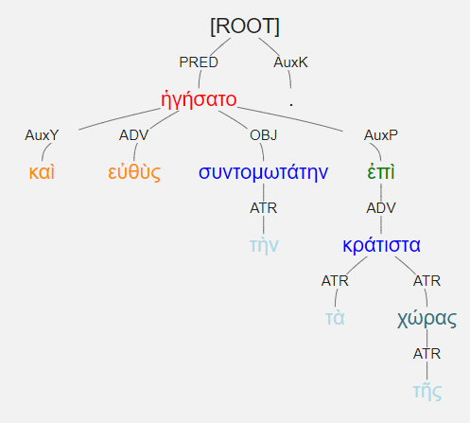
καὶ εὐθὺς ἡγήσατο τὴν συντομωτάτην ἐπὶ τὰ κράτιστα τῆς χώρας. [3.4.20]
And immediately he led them along the shortest routes to the best parts of the land.

Slide 10
Irregular comparatives use the third declension forms, with M/F the same
ἐλάσσων, ἔλασσον = ἐλάττων, ἔλαττον (Attic)
Less, fewer
Serves as comparative form of μικρός (small)
 | M/F | NT
Nom | ἐλάσσων/ἐλάττων | ἔλασσον/ἔλαττον
Gen | ἐλάττονος
Dat | ἐλάττονι
Acc | ἐλάττονα | ἔλαττον
Nom | ἐλάττονες | ἐλάττονα
Gen | ἐλαττόνων
Dat | ἐλάττοσι(ν)
Acc | ἐλάττους; ἐλάττονας | ἐλάττονα; ἐλάττω

Slide 11
Adverbs of note
μάλα = very
μᾶλλον = more
μάλιστα = especially

Slide 12
Comparison
Dative of degree difference (taller by a foot)
Genitive of comparison (taller than him)
ἢ = than [note: the same word as “or”]
the thing being compared in the same case as the thing to which it is being compared
μᾶλλον (ἤ) = more than, rather than
Comparisons can be strengthened using πολύ (much)

Slide 13
Superlatives
Often used with the partitive genitive
τῶν δὲ ἀνδρῶν οἱ μὲν πλεῖστοι ἐξέφυγον. [1.5.14]
ὡς + superlative = as … as possible
Κῦρος ὡς προθυμότατος πρὸς τὸν πόλεμον ἐγίγνετο.

Slide 14
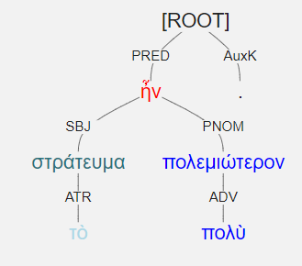
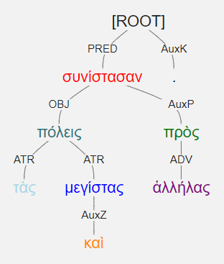
τὸ στράτευμα πολὺ πολεμιώτερον ἦν.
The expedition was much more warlike.
συνίστασαν καὶ τὰς μεγίστας πόλεις πρὸς ἀλλήλας. [3.5.2]
They combined even the greatest cities together with each other.

Slide 15
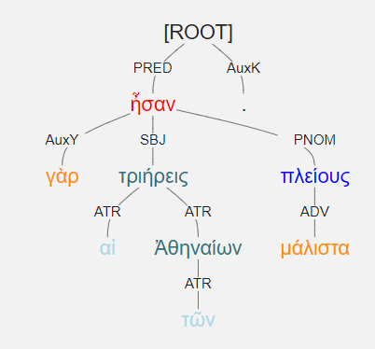
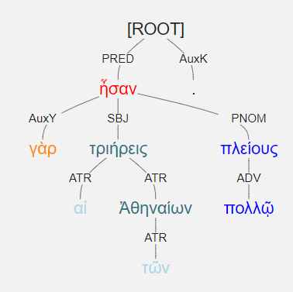
αἱ γὰρ τριήρεις τῶν Ἀθηναίων πολλῷ πλείους ἦσαν.
The Athenians had many more triremes.
Literally: The triremes of the Athenians were more by many.
αἱ γὰρ τριήρεις τῶν Ἀθηναίων μάλιστα πλείους ἦσαν.
The triremes of the Athenians were especially numerous.

Slide 16
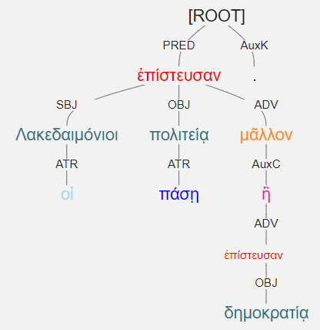
οἱ Λακεδαιμόνιοι πάσῃ πολιτείᾳ μᾶλλον ἢ δημοκρατίᾳ ἐπίστευσαν. [2.3.45]
The Lakedaimonians trusted every government system more than [they trusted] democracy.

Slide 17
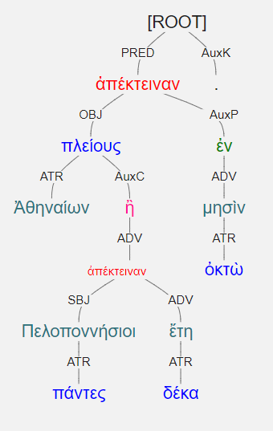
ἀπέκτειναν πλείους Ἀθηναίων ἐν ὀκτὼ μησὶν ἢ πάντες Πελοποννήσιοι δέκα ἔτη. [2.4.21]
They killed more Athenians in eight months than all the Peloponnesians killed in ten years.

